Slide 1
Lecture 10 (Chapter 14)
Exception Handling

Slide 2
Chapter 14 Topics
Introduction to Exception Handling
Exception Handling in C++
Exception Handling in Java

Slide 3
Introduction to Exception Handling
Early languages no language constructs for exception handling
In a language without exception handling
When an exception occurs (e.g. divide by zero) control goes to the operating system, where an error message is displayed and the program is terminated
A language that does not have exception handling capabilities can still define, detect, raise, and handle exceptions (user defined, software detected), e.g.
Use built-in function to detect exceptions
if (fin.eof()) { … end of file error … }
Send an auxiliary parameter or use the return value to indicate the return status of a subprogram, e.g.
int main () { … if (no error) return 0; else return 1; }
Pass an exception handling subprogram to all subprograms
…

Slide 4
How did programmers survive at early days when there wasn’t any language supported exception handling mechanism?

Slide 5
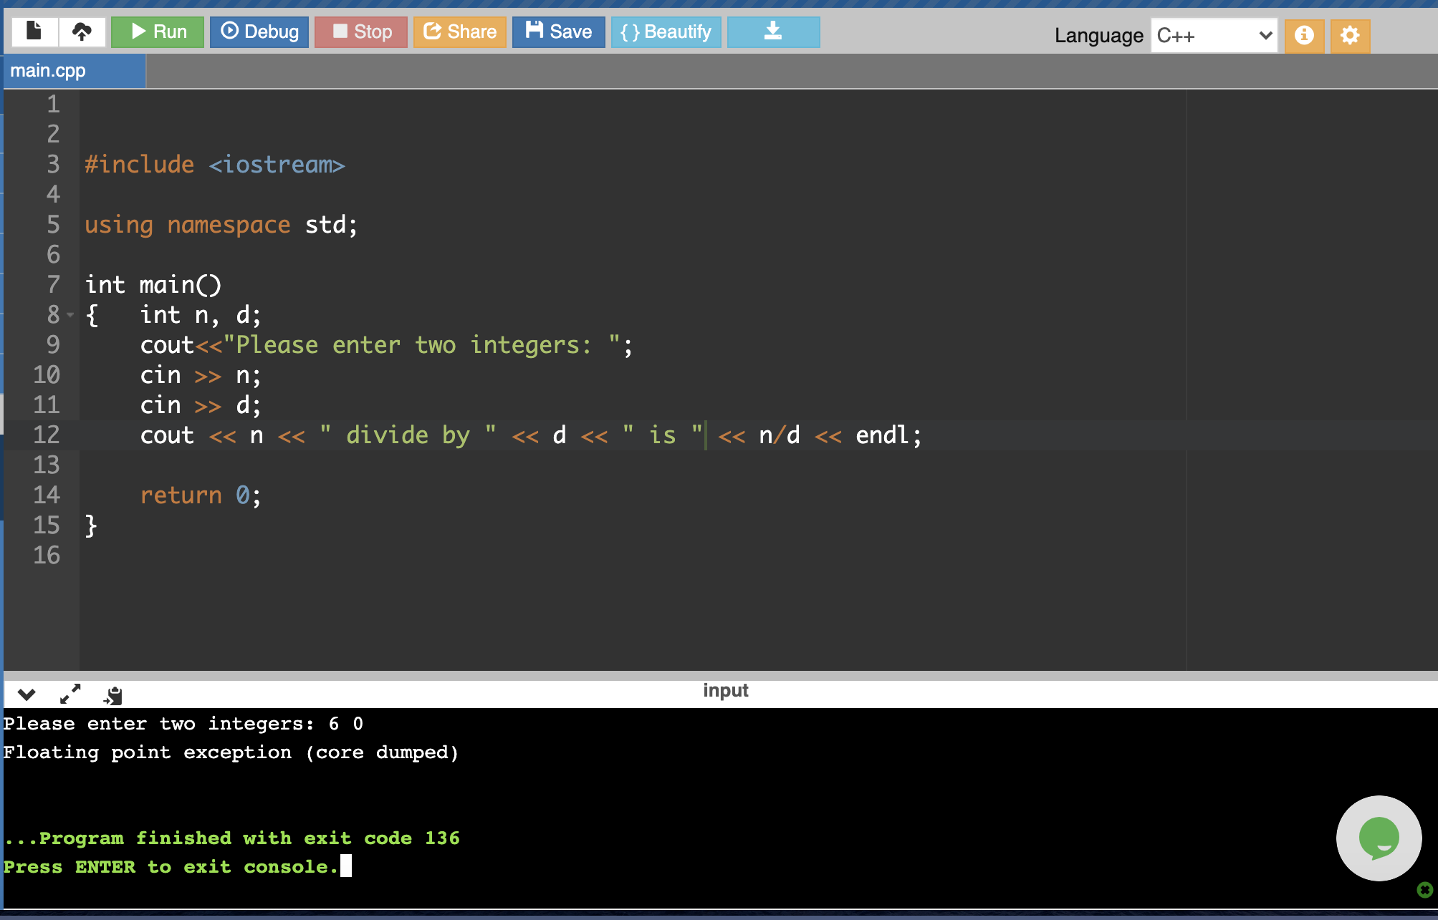
Scenario 1: When exception occurs control goes to OS where error msg displayed and program terminated
C++: Divide by zero exception

Slide 6
Scenario 2: Programmer adds protection
if (d == 0 )
cout << “divide by zero error\n”;
else
cout << “quotient is: “ << n/d << “\n”;
cout << “now we continue”;
Compare with previous case, now in case d is 0, a message will be displayed and program will continue to execute.

Slide 7
Scenario 3: Aided with built-in function
//fin: a file stream opened successfully
while (!fin.eof()) { //while not end of file
data = fin.read();
…
}
!eof() protects read() from hitting an exception when no more data to read. Similar strategy could be used for preventing other exceptions such as file not exist when opening.
Without built-in functions such as eof(), programmers are not able to code the protection.

Slide 8
Scenario 4: errors occurred in subprograms
double my_div (double n, double d, int & flag) {
if (d == 0) {flag = 1; return 0.0; }
else { flag = 0; return n/d;}
}
int main () {
int error;
…
result = my_div (5, 0, error); //a status flag from the subprogram
if (error) { return 1; } else { … display result …}
…
}

Slide 9
Now, almost every newer language comes with language supported exception handling construct.

Slide 10
Basic Concepts
In a language with exception handling
Programs are allowed to trap some exceptions, thereby providing the possibility of fixing the problem and continuing
An exception is any unusual event, either erroneous or not, detectable by either hardware or software, that may require special processing
The special processing that may be required after detection of an exception is called exception handling
The exception handling code unit is called an exception handler
An exception is raised when its associated event occurs

Slide 11
Exception Handling: Advantages
Traditionally error detection code is tedious to write
Exception handling encourages programmers to consider many different possible errors
Exception propagation allows a high level of reuse of exception handling code

Slide 12
Design Issues
How and where are exception handlers specified and what is their scope?
How is an exception bound to an exception handler?
Where does execution continue, if at all, after an exception handler completes its execution?
Is some form of finalization provided?
How are user-defined exceptions specified?
Are there any predefined exceptions?
Should there be default exception handlers for programs that do not provide their own?
Can predefined exceptions be explicitly raised?
Are hardware-detectable errors treated as exceptions that can be handled?

Slide 13
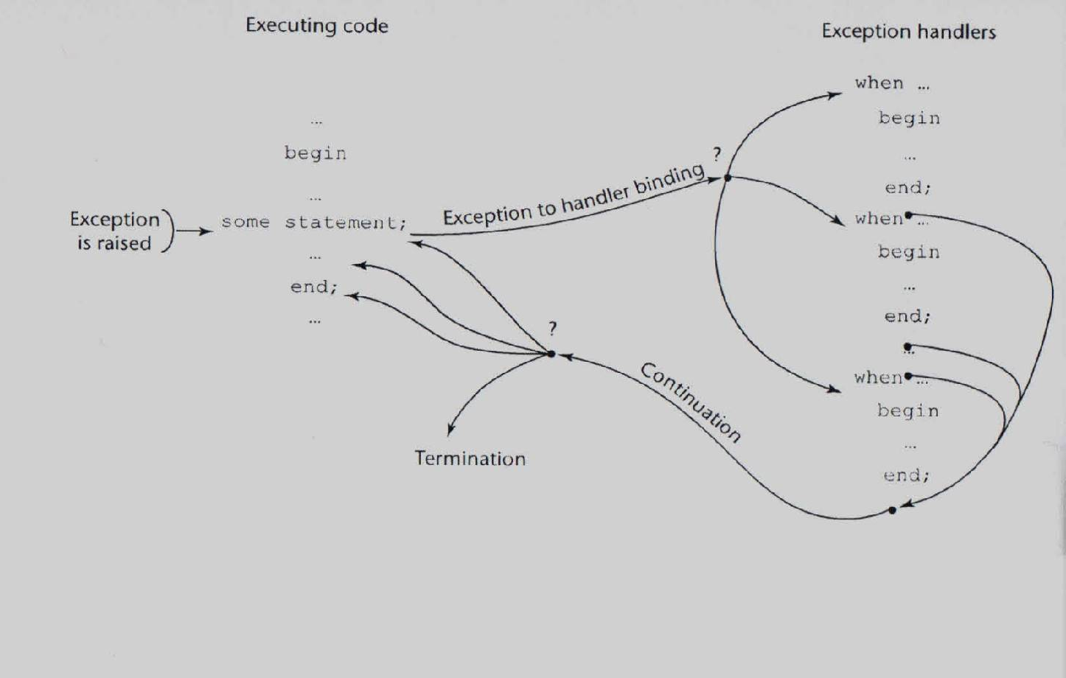
Exception Handling Control Flow

Slide 14
Exception Handling in C++
Added to C++ in 1990
Design is based on that of CLU, Ada, and ML
Exception Handlers Form:
try {
-- code that is expected to raise an exception
}
catch (formal parameter) {
-- handler code
}
...
catch (formal parameter) {
-- handler code
}

Slide 15
The throw and catch of Exceptions
Exceptions are all raised explicitly by the statement:
throw [expression];
A throw without an operand can only appear in a handler; when it appears, it simply re-raises the exception
The type of the expression disambiguates the intended handler
catch is the name of all handlers
the formal parameter of each catch must be unique
The formal parameter need not have a variable
It can be simply a type name to distinguish the handler it is in from others
The formal parameter can be used to transfer information to the handler
The handler catch (…) will catch any unhandled exception

Slide 16
int main () {
…
cin >> a;
cin >> b;
try {
z = division(x, y);
cout << z << endl;
}
catch (const char* msg) {
cerr << msg << endl;
}
catch (double d) {
cerr << “not like” << d << ”as result”;
}
catch (…) { cerr << “other errors”; }
//e,g. error in cin >> a;
return 0;
}
double division(int a, int b) {
if( b == 0 ) {
throw ”Div by zero";
}
if (a == 0) {
throw 0.0;
return (a/b);
}

Slide 17
Control Flow
If a throw statement is executed, control goes to the catch block
If a handler is matched, after a handler completes its execution, control flows to the first statement after the last handler in the sequence of handlers;
If no handler is matched, the exception is unhandled
Unhandled exceptions
An unhandled exception is propagated to the caller of the function in which it is raised
This propagation continues to the main function
If no handler is found, control goes to the OS (to call default exception handler provided by the OS)

Slide 18
Control Flow: Python vs. C++
try :
A
except myException :
B
else :
C
finally :
D
def divide(x, y):
try:
result = x / y
except ZeroDivisionError:
print("division by zero!")
else:
print("result is", result)
finally:
print("executing finally clause")
else block: executed when no exception occurs
finally block: always executed.

Slide 19
Default handler: Python vs. C++
Python:
def divide(x, y):
try:
result = x / y
except ZeroDivisionError:
print("division by zero!")
except:
print(“Catch’em all!”)
else:
print("result is", result)
finally:
print("finally clause")
C++:
try {
z = division(x, y);
}
catch (…) { cerr << “other errors”; }
return 0;
}
What about Java?

Slide 20
Features and Evaluation
Exceptions are neither specified nor declared
Binding exceptions to handlers through the type of the parameter certainly does not promote readability
Functions can list the exceptions they may raise
Without a specification, a function can raise any exception (the throw clause)
There are no predefined exceptions
All exceptions are user-defined
a list of standard exceptions defined in <exception>
It is odd that exceptions are not named and that hardware- and system software-detectable exceptions cannot be handled

Slide 21
Exception Handling in Java
Based on C++, but more in line with OOP philosophy
All exceptions are objects of classes that are descendants of the Throwable class
The Java library includes two subclasses of Throwable :
Error
Thrown by the Java interpreter for events such as heap overflow
Never handled by user programs
Exception
User-defined exceptions are usually subclasses of this
Has two predefined subclasses
IOException e.g., EOFException
RuntimeException e.g., ArrayIndexOutOfBoundsException

Slide 22
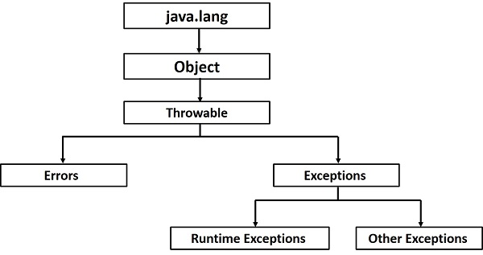
Reference

Slide 23
Java Exception Handlers
Every catch requires a named parameter and all parameters must be descendants of Throwable
Syntax of try clause is exactly that of C++
Exceptions are thrown with throw, as in C++
An exception is bound to the first handler with a parameter is the same class as the thrown object or an ancestor of it
If no handler found, it propagates to the caller as in C++
It is suggested to add a handler (as the last catch clause) to catch all exceptions
Simply use an Exception class parameter
An exception can be handled and rethrown by including a throw in the handler (a handler could also throw a different exception)

Slide 24
Checked and Unchecked Exceptions
Unchecked Exceptions
Exceptions of class Error and RunTimeException and all of their descendants (all others are checked exceptions)
Checked Exceptions
Checked exceptions are checked at compile-time.
It means if a method is throwing a checked exception then it should handle the exception using try-catch block or it should declare the exception using throws keyword, otherwise the program will give a compilation error.
throw vs. throws (Example next slide)
A method that calls a method with a particular checked exception in its throws clause has three alternatives:
Catch and handle the exception
Catch the exception and re-throw an exception (could be a different exception) listed in its own throws clause
Declare the same exception in its throws clause and do not handle it

Slide 25
throw vs. throws
void myMethod() {
try {
//throwing arithmetic exception using throw
throw new ArithmeticException("Something went wrong!!");
}
catch (Exception exp) {
System.out.println("Error: "+exp.getMessage());
}
}
class Example {
public static void main(String args[]) throws IOException
{ //IOException will not be handled in main()
FileInputStream fis = null;
fis = new FileInputStream("B:/myfile.txt");
…
fis.close();
}

Slide 26
The finally Clause
class TestFinallyBlock{
public static void main(String args[]) {
try {
int data=25/5;
System.out.println(data);
}
catch(NullPointerException e) {
System.out.println(e);
}
finally {
System.out.println(”always executed");
}
System.out.println("rest of the code...");
} //end of main
} //end of class
Can appear at the end of a try construct
finally {
...
}
Purpose: To specify code that is to be executed, regardless of what happens in the try construct

Slide 27
Evaluation
The types of exceptions makes more sense than in the case of C++
The throws clause makes clear indication for (unhandled) exception propagation.
However, confusion between throw and throws
The finally clause is often useful
The Java interpreter throws a variety of exceptions that can be handled by user programs
A large set of built-in exceptions (Reference)
Complexity in checked and unchecked exceptions
pros and cons?

Slide 28
Summary
History
Ada, one of the first languages with comprehensive exception handling features, provides extensive exception-handling facilities with a large set of built-in exceptions.
C++ includes no predefined exceptions
Exceptions are bound to handlers by connecting the type of expression in the throw statement to that of the formal parameter of the catch function
Java exceptions are similar to C++ exceptions except that a Java exception must be a descendant of the Throwable class. Additionally Java includes a finally clause

